Slide 1
Spotify Analytics Dashboard
POWER BI DASHBOARD ANALYSIS
NAME – AAKASH MITRA
STUDENT CODE – AF05030049

Slide 2
AGENDA
Business Context & Objectives
Data & Dashboard Overview
KPI Performance
Popularity & Time-Based Trends
Artist & Content-Type Analysis
Insights
Limitations
Recommendations
Conclusion

Slide 3
Business Context & Objectives
Business Context
Business Objectives
Digital music platforms like Spotify operate in a highly competitive, data-driven environment where user engagement, content performance, and artist visibility directly impact revenue and retention. With millions of tracks available, identifying what content performs well and why is critical for informed decision-making.
This project uses Spotify music data to understand listener preferences, popularity trends, and artist performance, enabling stakeholders to make strategic content and promotion decisions.
The key objectives of this dashboard are:
To analyze song popularity trends over time
To identify high-performing artists and tracks
To evaluate the performance of singles versus albums
To support data-driven content and marketing strategies
To provide an interactive dashboard for quick decision-making

Slide 4
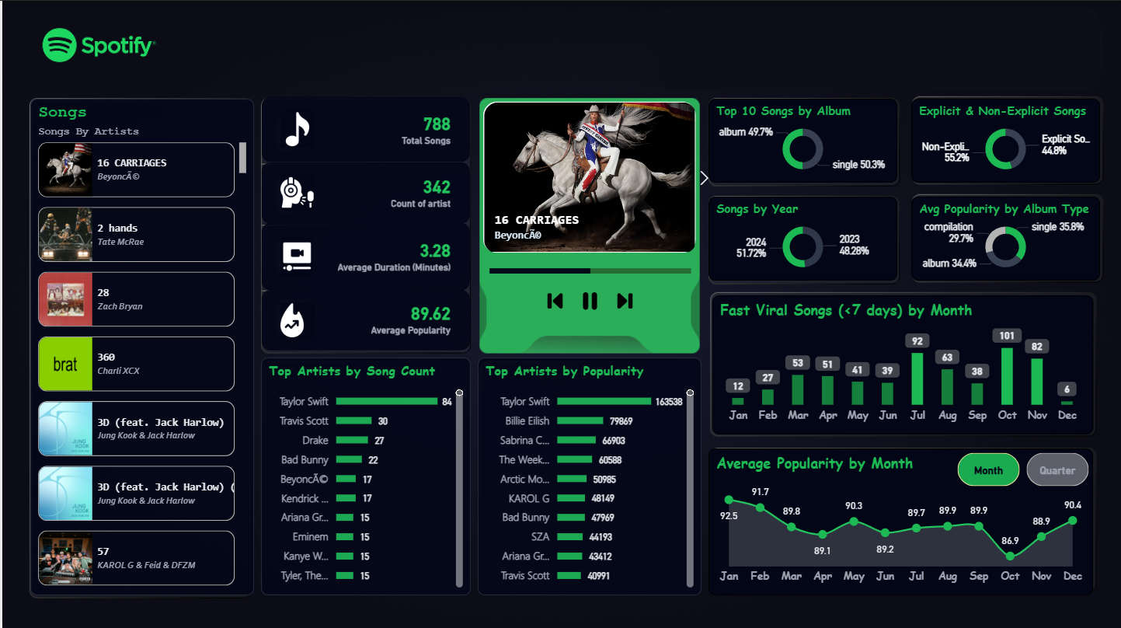
Spotify Dashboard – Overview

Slide 5
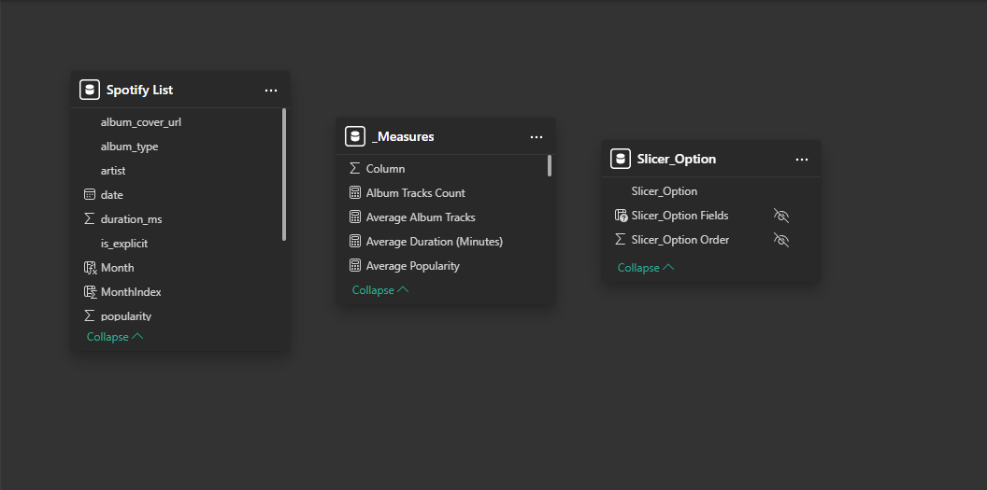
Data Model & DAX Measure Architecture

Slide 6
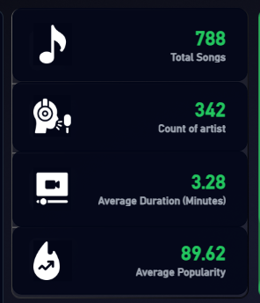
KPI card
Total Songs (788): Represents the overall size of the music catalog analyzed in this project, providing a strong data foundation for identifying trends, patterns and performance insights.
Count of Artists (342): Indicates a diverse range of contributing artists, enabling meaningful comparison of artist presence and understanding of content distribution across the platform.
Average Duration (3.28 mins): Reflects the typical length of songs in the dataset, suggesting alignment with standard listener preferences and optimized consumption behavior.
Average Popularity (89.62): Demonstrates a high level of listener engagement across tracks, indicating that the dataset is dominated by well-performing and popular content.

Slide 7
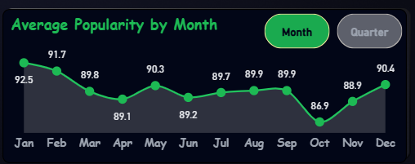
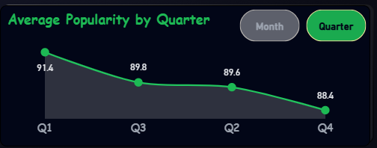
Average Popularity
Consistent High Popularity Across the Year: The chart shows that average popularity remains strong throughout most months, indicating stable listener engagement rather than sharp fluctuations.
Peak Performance in Early and Late Months: Higher popularity levels are observed in months like January, February, and December, suggesting increased listener activity during the beginning and end of the year.
Mid-Year Stabilization: Popularity dips slightly around March to June, but remains within a narrow range, indicating controlled variation rather than performance decline.
Notable Drop in October: October shows the lowest average popularity, highlighting a potential seasonal or release-cycle impact that may require deeper analysis.
Strong Recovery Towards Year-End: The upward trend from November to December reflects renewed engagement, possibly driven by major releases, promotions, or holiday listening behavior.
Strong Performance in Q1: Q1 records the highest average popularity, indicating strong listener engagement at the beginning of the year, possibly driven by new releases and fresh content cycles.
Gradual Decline Across Quarters: The chart shows a steady decrease in popularity from Q1 to Q4, suggesting a gradual shift in listener engagement rather than sudden drops.
Stable Mid-Year Engagement: Q2 and Q3 maintain relatively close popularity values, reflecting consistent performance during the mid-year period.
Lowest Popularity in Q4: Q4 shows the lowest average popularity, highlighting potential seasonality effects or reduced release momentum during this period.
Strategic Planning Insight: Quarterly trends indicate that releasing high-impact content earlier in the year may maximize engagement and popularity outcomes.

Slide 8
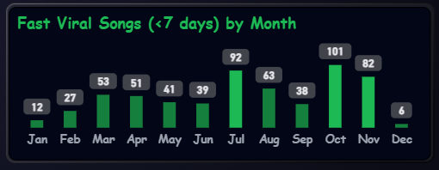
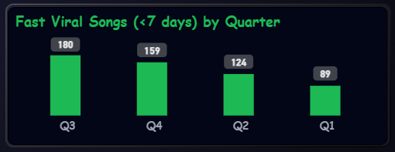
Fast viral songs
Seasonal Spikes in Viral Content: The number of fast-viral songs shows clear seasonal variation, with significant spikes in July and October, indicating periods of rapid listener adoption.
October as the Peak Viral Month: October records the highest count of fast-viral songs, suggesting strong release momentum, promotional activity, or heightened audience engagement during this period.
Moderate Viral Activity During Mid-Year: Months like March, April, and August show steady viral counts, reflecting consistent but controlled content traction.
Lower Viral Activity at Year Boundaries: January and December exhibit fewer fast-viral songs, possibly due to reduced release frequency or shifting listener behavior during holiday periods.
Actionable Content Strategy Insight: Identifying months with higher viral potential enables strategic planning of releases to maximize early traction and visibility.
Q3 Leads in Rapid Virality: Q3 records the highest number of fast-viral songs, indicating stronger audience responsiveness and higher chances of songs gaining quick traction during this quarter.
Strong Viral Momentum in Q4: Q4 follows closely behind Q3, suggesting that late-year periods are favorable for rapid content discovery and sharing.
Moderate Viral Performance in Q2: Q2 shows a balanced level of fast-viral songs, reflecting steady engagement without extreme peaks.
Lowest Viral Activity in Q1: Q1 has the fewest fast-viral tracks, highlighting comparatively slower early-year adoption of new releases.
Strategic Release Timing Insight: The quarterly trend suggests that launching high-potential songs in Q3 or Q4 can significantly increase the probability of rapid viral success.

Slide 9
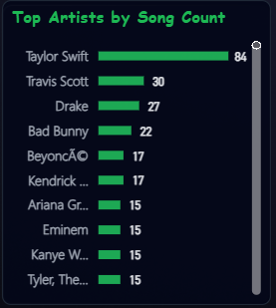
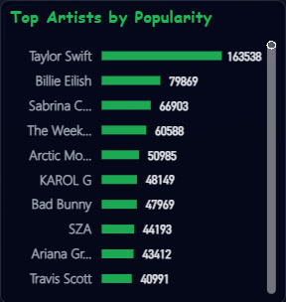
Top Artists
Top Artists by Song Count
Clear Artist Dominance: Taylor Swift leads by a wide margin in the number of songs, indicating a strong catalog presence and high content contribution within the dataset.
Concentration of Content Among Top Artists: A small group of artists such as Travis Scott, Drake, and Bad Bunny contribute a significant share of songs, showing content concentration at the top.
Diversity Beyond the Top Tier: Artists like Beyoncé, Kendrick Lamar, Ariana Grande, and Eminem show balanced representation, reflecting diversity beyond the leading artist.
Strategic Artist Insight: Identifying high-volume artists helps platforms prioritize partnerships, promotions, and catalog curation strategies.
Top Artists by Popularity
Overall Popularity Leadership: Taylor Swift ranks highest in cumulative popularity, indicating exceptional listener engagement and sustained impact across her music catalog.
Strong Tier of High-Engagement Artists: Artists such as Billie Eilish, Sabrina Carpenter, and The Weeknd form a strong second tier, reflecting consistent popularity and broad audience appeal.
Global and Genre Diversity: The presence of artists like KAROL G, Bad Bunny, and Arctic Monkeys reflects diverse genres and global reach contributing to high popularity scores.
Strategic Business Implication: Popularity-based ranking helps platforms and labels identify artists with the greatest engagement potential for promotions, recommendations, and collaborations.

Slide 10
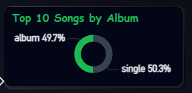
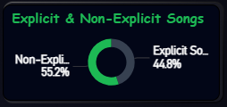
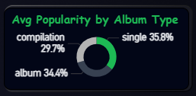
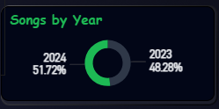
Content Distribution & Performance Insights
Top 10 Songs by Album Type
The top-performing songs are almost evenly split between Singles and Albums, indicating no heavy dependency on a single release format.
Singles marginally outperform albums, suggesting faster audience adoption and visibility.
Albums continue to hold strong relevance, proving long-form releases still attract engagement.
This balance highlights flexibility in content strategy without risking performance.
Explicit vs Non-Explicit Songs
Non-explicit songs dominate the dataset, indicating broader audience reach and higher acceptance.
Explicit content, while significant, appeals to a comparatively narrower listener base.
Platforms may prefer non-explicit tracks for wider promotion and algorithmic reach.
Content creators can leverage non-explicit releases to maximize discoverability.
Average Popularity by Album Type
Singles record the highest average popularity, making them the most impactful format.
Albums follow closely, indicating sustained engagement beyond single-track releases.
Compilation tracks show comparatively lower popularity, suggesting niche appeal.
This insight supports prioritizing singles for engagement-driven strategies.
Songs by Year (2023 vs 2024)
2024 contributes a slightly higher share of songs, showing increased recent activity.
Newer releases are gaining traction faster compared to older content.
This reflects evolving listener preferences toward fresh and trending music.
Recent-year dominance supports focusing on current and upcoming releases.

Slide 11
Key Insights
Singles demonstrate higher engagement and faster adoption compared to albums and compilations. This indicates that listeners prefer shorter, focused releases, making singles a powerful tool for gaining visibility and sustaining interest.
Artist dominance plays a critical role in popularity distribution, where a small group of top artists contributes a large share of highly popular and viral songs. This reflects the influence of strong fan bases and brand recognition in driving engagement.
Listener behavior shows clear seasonal patterns, with noticeable peaks in popularity and viral activity during specific months and quarters. This suggests that release timing significantly impacts a song’s performance.
Non-explicit content achieves wider reach and higher acceptance, enabling platforms to promote such tracks more aggressively across playlists, recommendations, and global audiences.
Recent releases outperform older content, highlighting a strong audience preference for fresh and trending music, and emphasizing the importance of continuous content updates.

Slide 12
Limitations
The analysis is based on a static dataset, which restricts the ability to track real-time trends, sudden spikes in popularity, or ongoing listener behavior changes.
Popularity metrics are defined by the platform, and may not fully capture qualitative factors such as emotional impact, cultural relevance, or long-term listener loyalty.
The absence of user-level and demographic data limits personalized insights, such as age-based, region-based, or behavior-driven analysis.
Genre-level classification is not available, preventing deeper exploration of music preferences across different genres and styles.
Predictive insights are constrained due to the lack of historical behavioral patterns and streaming frequency data.

Slide 13
Recommendation
Adopt a single-first release strategy, especially for emerging artists or promotional campaigns, to maximize early engagement and visibility.
Leverage high-performing artists strategically through collaborations, playlist placements, and targeted marketing to amplify reach and retention.
Time releases around high-engagement periods, particularly during quarters and months that show strong viral behavior, to increase the chances of rapid popularity growth.
Prioritize non-explicit content for broader promotions, ensuring accessibility across diverse listener groups and regions.
Enhance future dashboards by integrating real-time streaming data, genre classification, and user behavior metrics to enable predictive analytics and personalized recommendations.

Slide 14
Conclusion
This project demonstrates the effective use of Power BI to transform raw Spotify music data into meaningful, actionable business insights. By applying structured data cleaning, optimized data modeling, and well-designed DAX measures, the dashboard delivers a clear and interactive view of music performance, artist contribution, and listener engagement trends.
The analysis reveals important patterns such as the dominance of single releases, the strong influence of top-performing artists, and the impact of release timing on popularity and virality. Seasonal trends and content-type comparisons further highlight how data can guide strategic decisions in content planning and promotion.
Despite limitations such as the use of a static dataset and platform-defined popularity metrics, the dashboard successfully provides valuable insights that are relevant for music platforms, marketing teams, and artist management. The project reflects strong analytical thinking, business understanding, and visual storytelling skills.
Overall, this dashboard bridges the gap between data and decision-making, showcasing how analytics can support smarter content strategies, improved audience engagement, and scalable business growth in the digital music industry.

Slide 15
Thank You

